Slide 1
13. Hash Tables, Part 2
ECE 309
Dr. James Tuck

Slide 2
Objectives
Describe and implement two techniques for dealing with collisions: linear probing and chaining
Derive implementations for linear probing and chaining, and key operations: insert, search, and remove
Discuss hash functions, properties, and making ones for custom objects.

Slide 3
What happens if we have a collision?
A collision occurs when two data items belong in the same bucket.
What should we do on a collision?
Over-write the old item (a bad approach)
Or, we could drop the new one and return false (a little better)
Or, we could add it somewhere else in the hash table (this is the best option in most cases) - we will come back to this
Linear probing, Chaining

Slide 4
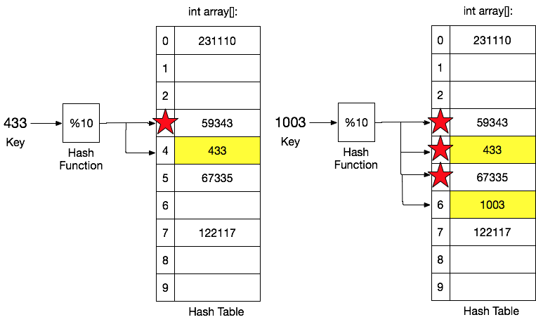
Approach 1: Linear probing to avoid collisions
If the default entry is occupied, go to the next empty index and use it instead

Slide 5
How far to probe?
How many entries should we check on a collision?
It’s critical that we keep an O(1) insertion time.
For example, if we check the entire table, insertion becomes O(n)
We check a small but constant number of entries beyond the hash index. Let’s call it probeDistance

Slide 6
IntegerSetHT::insert
bool IntegerSetHT::insert(int data)
{
int index = hash(data);
int bucketsProbed=0;
while (bucketsProbed++ < probeDistance) {
if (table[index] < 0) {
table[index] = data;
return true;
}
index = (index+1)%size; // (% size) lets us wrap around to first index
}
return false;
}

Slide 7
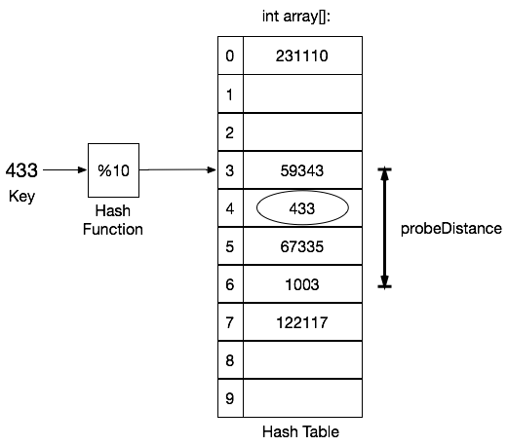
Search with linear probing
Check for a match at the index
If we don’t find it, check all entries within the probeDistance
Problem: inefficient for hash tables with few collisions

Slide 8
Three types of hash table buckets
To make search more efficient, we can classify buckets into three categories:
valid: currently holding data
empty-since-start: entry has never held data
empty-after-removal: entry used to hold data but doesn’t now due to a removal

Slide 9
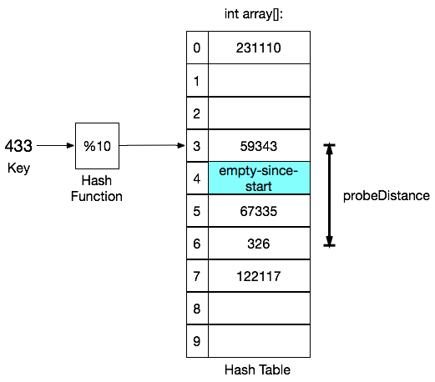
Search with linear probing
Check all entries within the probeDistance
But, if we reach an empty-since-start entry, we can stop searching
Why: linear probing places entries at the following indices, and if it’s never been used, then we never inserted there using linear probing

Slide 10
IntegerSetHT::search
bool IntegerSetHT::search(int data)
{
int index = hash(data);
int bucketsProbed=0;
while (table[index] != emtpy_since_start && bucketsProbed++ < probeDistance)
{
if (table[index] == data)
return true;
index = (index+1)%size; // (% size) lets us wrap around to first index
}
return false;
}

Slide 11
IntegerSetHT::remove
void IntegerSetHT::remove(int data)
{
int index = hash(data);
int bucketsProbed=0;
while (table[index] != emtpy_since_start && bucketsProbed++ < probeDistance)
{
if (table[index] == data)
table[index] = empty_after_removal;
index = (index+1)%size; // (% size) lets us wrap around to first index
}
}

Slide 12
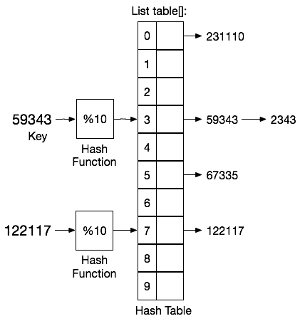
Approach 2: Chaining
Chain all of the data in the same bucket together in a linked list.
The table is now an array of linked lists.

Slide 13
IntegerSetHTChain derived class
class IntegerSetHTChain : public IntegerSet {
List<int> *table; // pointer to the table
public:
IntegerSetHTChain(int htsize=1000);
// override functions from IntegerSet
void insert(int) override;
bool search(int) override;
void remove(int) override;
};

Slide 14
Constructor and insert
IntegerSetHTChain::IntegerSetHTChain(int htsize=1000)
:IntegerSet(htsize)
{
table = new List<int> [size]; // array of lists, default constructed
}
bool IntegerSetHTChain::insert(int data)
{
List::iterator it;
table[hash(data)].insertAfter(it,data);
return true;
}

Slide 15
IntegerSetHTChain::search
bool IntegerSetHTChain::search(int data)
{
List::iterator it = table[hash(data)].begin();
while(!it.end())
{
if (it.getInt()==data) return true;
it.increment();
}
return false;
}

Slide 16
IntegerSetHTChain::remove
bool IntegerSetHTChain::remove(int data)
{
List::iterator prev, it = table[hash(data)].begin();
while(!it.end()) {
if (it.getInt()==data) {
table[hash(data].removeAfter(prev);
return true;
}
prev = it;
it.increment();
}
return false;
}

Slide 17
Is a chained hash table lookup still O(1)?
Assume we put M items in a size N hash table, and we have a perfect hash function
Assume N = c * M, where c is a constant and c > 1.
Each bucket has M/N = 1/c (<1) in a single chain
Because c is a constant, O(1/c) is O(1)
If our assumptions do not hold, we may fail to get O(1)!
It’s very important that we size our table large enough, and have a good hash function.

Slide 18
Linear probing versus Chaining
Linear probing is faster when you know the amount of data in advance:
It uses empty space within the hash table efficiently
Doesn’t need to allocate additional memory as long as collisions are infrequent.
But, number of hashed items ultimately limited by hash table size.
Quick search of adjacent buckets (i.e. no list traversal)
But, more sensitive to the quality of the hash function
It’s possible that we run out of buckets within the probeDistance: (1) due to collisions on the same bucket, and (2) hashing to adjacent buckets. In this case, resize the table to be larger.
Chaining tolerates more uncertainty in the volume of data
Insertion is always fast, because items are pushed onto a list in O(1)
We can always add items to a chain; not limited by hash table size.
Search can be slower (list traversal), but most chains have 0 or 1 item
Collisions degrade the efficiency of search
If chains become long, the table needs to be larger (remove all and re-insert into larger table)

Slide 19
Other important topics for hash tables
Rather than linear probing, we could use multiple hash functions to find an empty location
Sometimes used in hardware caches (ECE 463) due to the high latency of accessing main memory.
There are many common hash functions (ZyBook 15.7), but two important classes:
String hash functions, integral hash functions (applicable to pointers)
It’s important to make sure the hash function is computed in O(1)
Strings have arbitrary length, one must be careful

Slide 20
Hash function
A perfect hash function would spread keys uniformly across buckets, avoiding collisions.
Perfect hash functions don’t exist
But, we use them as a comparison point for analysis
Modulo hash functions use the remainder after moduloing by the size of the table (forces indices in proper range)
index = key % size
This appears good at first, but can cause problems if the keys share a common factor (e.g. 100, 200, 300 all hash to 0 with modulo 100)

Slide 21
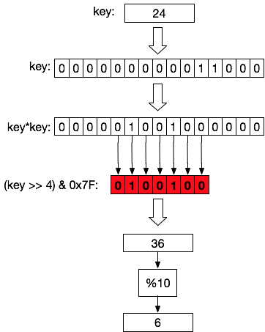
Mid-square integer hash function
Idea: Randomize the bits used before taking the modulo
Square the key (key*key)
Extract the middle N bits, where N >= log₂(size)
Modulo the result with the size of the hash table
Many others out there. Search “integer hash function”

Slide 22
String hash function
Daniel J. Bernstein created a popular string hash function:
int djb2(const char * str, int size) {
int val = 5381; // randomize starting point
for(int i=0; str[i]!=’\0’; i++)
val = val*33 + str[i]; // accumulate characters into a single value
return val % size;
}

Slide 23
What about hashing other kinds of objects?
Objects are made up of fields that are integers, pointers, strings, etc.
Pick one field that uniquely identifies the object (i.e. name, ID number, phone number, etc.) and use that as the hash key.
Based on its type, select a good hash function
If no single field is unique, multiply or concatenate fields together to form a plausibly unique key.
Example: Neither first name or last name is very unique, so concatenate first name and last name to make the key (still no guarantee, but better).

Slide 24
Can we make the hash function easy to customize?
Given the variety of hash functions, and their dependence on actual data values ...
We should make it easy to customize a hash function, rather than hard coding it inside an object.
Solution: specify the hash function as an object and use it to specialize the hash table.

Slide 25
Example hash function object
class hash_int_fn {
public:
// function call operator
int operator() (int key, int size) {
return (key * 997) % size;
}
};
// example of how to use it in a function:
hash_int_fn f;
// uses operator() member function
int index = f(/*key=*/ 24,/*size=*/ 100);

Slide 26
Example
Change the IntegerSetHT class to take a template parameter that specifies a hash function object to use.
Modify all places where the hash function is called to use the object instead.

Slide 27
Summary
Linear probing uses adjacent buckets to hold an item on a collision: critical to limit number of adjacent buckets that are checked.
Chaining allocates a linked list for each bucket, guaranteeing insertion even in the case of collisions.
Even though O(1) on average, managing a list has slightly higher constant-time costs than linear probing.
If the hash function is poor, a single bucket’s list could grow very long.
Both linear probing and chaining depend on effective hash functions and a properly sized table -- poor choices for either can compromise efficiency.
Other important topics about hash tables are covered in the ZyBook Ch. 15.

Slide 28
References
1. ZyBook on Data Structures, chapter 15

